Slide 1


Introduction to Light Dependent Resistors (LDRs)
This presentation will provide an introduction to Light Dependent Resistors (LDRs), also known as photoresistors. We'll explore their basic function, construction, working principle, and applications.
by swaraj upgrad

Slide 2
LDR Construction and Materials
Semiconductor Materials
Serpentine Pattern
Encapsulation
The semiconductor material is arranged in a serpentine pattern, increasing surface area for better light absorption.
An epoxy resin or similar protective coating encloses the semiconductor material, protecting it from the environment.
LDRs are made from semiconductor materials like Cadmium Sulfide (CdS), which exhibit photoconductivity.

Slide 3
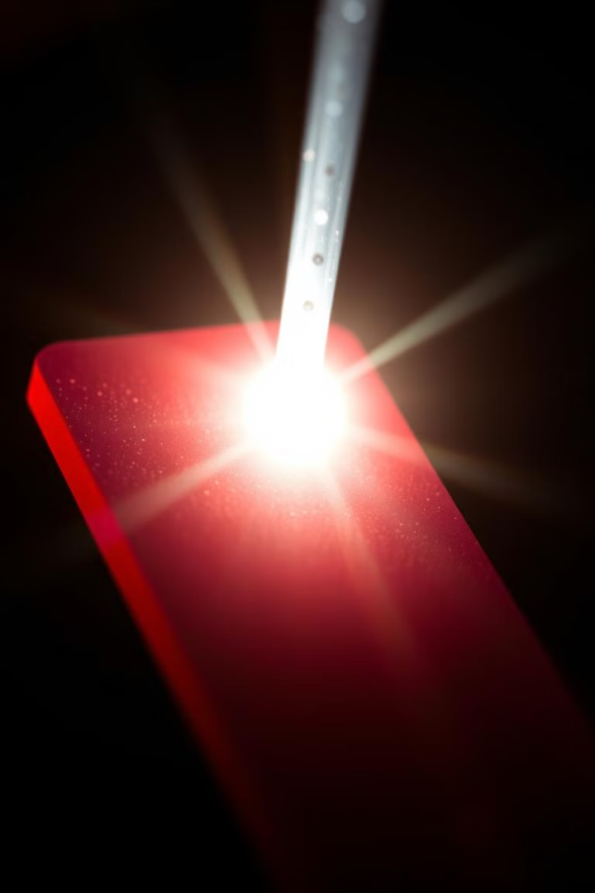
How LDRs Work: The Physics
When light strikes the LDR, photons excite electrons in the semiconductor material.
This excitation creates electron-hole pairs, increasing the material's conductivity.
The LDR's resistance decreases with increasing light intensity.

Slide 4

LDR Characteristics and Specifications
Resistance Range
Spectral Response
Response Time
LDRs typically exhibit resistance ranging from Megaohms in darkness to hundreds of ohms in bright light.
The sensitivity to different wavelengths of light is referred to as the LDR's spectral response.
The time it takes for the LDR's resistance to change in response to light is its response time.

Slide 5




Factors Affecting LDR Performance
Light intensity has a logarithmic relationship with LDR resistance.
Temperature changes can influence the resistance of the LDR.
Humidity can affect the LDR's surface conductivity and stability.

Slide 6

LDR Applications: Examples
Street Lighting
1
Automatic on/off based on ambient light
2
Camera Light Meters
Adjusting exposure settings
Alarm Systems
3
Detecting light beam interruption
4
Automatic Blinds
Controlling sunlight entering a room

Slide 7




LDR Circuit Design Considerations
Voltage Divider
Load Resistor
Amplifier Circuits
A common method for interfacing LDRs with other circuits.
Optimizing sensitivity and range of the LDR circuit.
Improving signal strength for better accuracy.

Slide 8
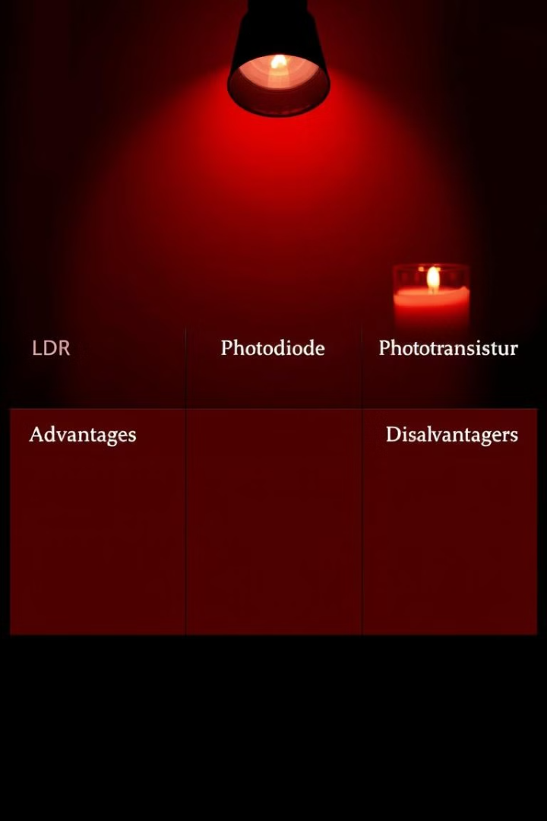
Advantages, Disadvantages, and Conclusion
Advantages
Simple, inexpensive, and easy to use.
Disadvantages
Slow response, temperature sensitivity, and aging effects.
Conclusion
LDRs are versatile light sensors with various applications.

